Slide 1
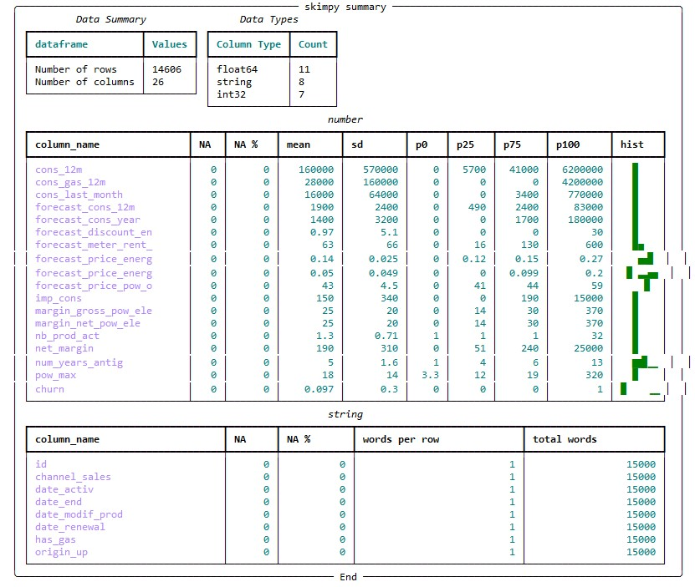
PowerCo Case Task Description

Slide 2
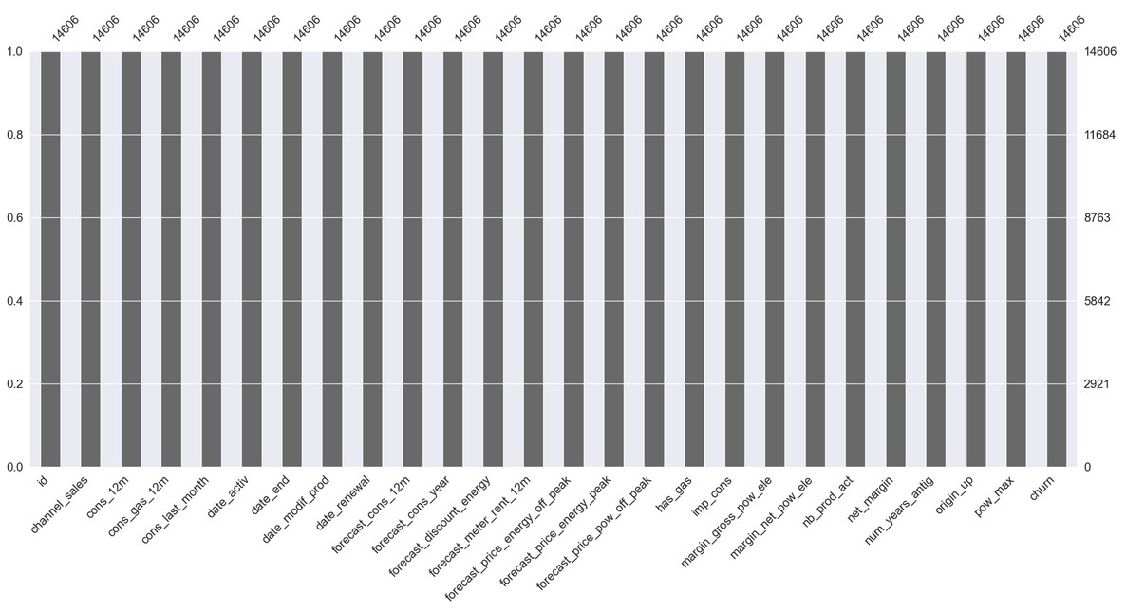
PowerCo Case Task Description

Slide 3
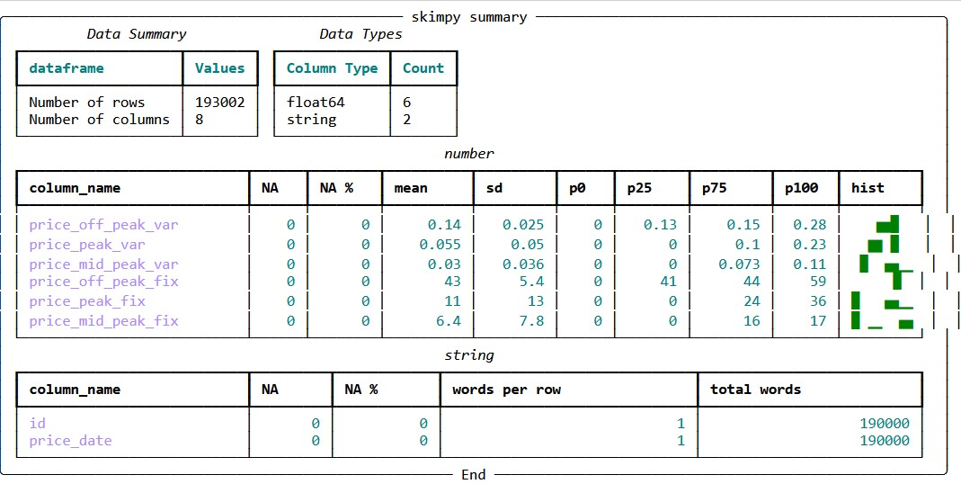

Slide 4
